Slide 1
MEASURES OF PARTITION
We have seen that the median is an average that
divides a distribution into two equal parts. So also these are other quantity that divides a set of data (in an array) into different equal parts. Such data must have been arranged in order of magnitude. Some of the partition values are: the quartile, deciles and percentiles.

Slide 2
All quantities that are defined as partitioning or splitting a distribution into a number of equal portions are called quantiles. Examples include the quartiles, deciles and the percentiles.
The three quantities that spilt a distribution into four equal parts are called Quartiles, namely (Q1), second quartiles (Q2) and the third quartiles, (Q3). Nine quantities spilt a distribution into ten equal parts. These are called Deciles namely first decile (D1), Second decile (D2), up to the ninth decile (D9). The Ninety-nine quantities that spilt a distribution into one hundred equal parts are called percentiles namely first Percentiles (P1), second Percentile (P2) up to the ninety-ninth percentile (P99).

Slide 3
THE QUARTILES
Quartiles divide a set of data in an array into four equal parts. For ungrouped data, the distribution is first arranged in ascending order of magnitude. Then
First Quartiles: [(N + 1)/4] th item
Second Quartile: 2[(N + 1)/4] th item
Third Quartile: 3[(N + 1)/4] th item
For a grouped data
Qw = L + [(wN/4 – Cf)/f] x I
w is the quality in reference
Cf is the cumulative freq before the quartile class
F is the frequency of the quartile class
I is the class size

Slide 4
DECILES
The values of the variable that divide the frequency of the distribution into ten equal parts are known as deciles and are denoted by the fifth deciles is the median.
For ungrouped data,
the distribution is first arranged in ascending order of magnitude. Then
Dw = w[(N + 1)/10] th item, where w is the quality in reference and w = 1,2,3, … , 9
For a grouped data
Dw = L + [(wN/10 – Cf)/f] x I

Slide 5
PERCENTILE
The values of the variable that divide the frequency of the distribution into hundred equal parts are known as percentiles and are generally denoted by P1, P2, … , P99
For ungrouped data,
the distribution is first arranged in ascending order of magnitude. Then
Pw = w[(N + 1)/100] th item, where w is the quality in reference and w = 1,2,3, … , 99
For a grouped data
Pw = L + [(wN/100 – Cf)/f] x I

Slide 6
Example: For the table below, find by calculation (using appropriate expression)
LOWER QUARTILE, Q1
UPPER QUARTILE, Q3
6TH DECILE, D6
45TH PERCENTILE, P45
Mark | 20 – 29 | 30 – 39 | 40 – 49 | 50 – 59 | 60 – 69 | 70 – 79 | 80 – 89 | 90 – 99
Frequ ency | 8 | 10 | 14 | 26 | 20 | 16 | 4 | 2

Slide 7
EXAMPLE
CALCULATE Q1 AND Q3 OF THE DISTRIBUTION BELOW;
WAGES | ˂35 | 35 -37 | 38 - 40 | 41 – 43 | ˃43
NO OF EARNERS | 14 | 62 | 99 | 18 | 7

Slide 8
MEASURES OF DISPERSION
Dispersion or variation is degree of scatter or variation of individual value of a variable about the central value such as the median or the mean. These include range, mean deviation, semi-interquartile range, variance, standard deviation and coefficient of variation.

Slide 9
THE RANGE
This is the simplest method of measuring dispersions. It is the difference between the largest and the smallest value in a set of data. It is commonly used in statistical quality control. However, the range may fail to discriminate if the distributions are of different types.
Coefficient of Range = (L – S)/(L+S)
Range = L - S

Slide 10
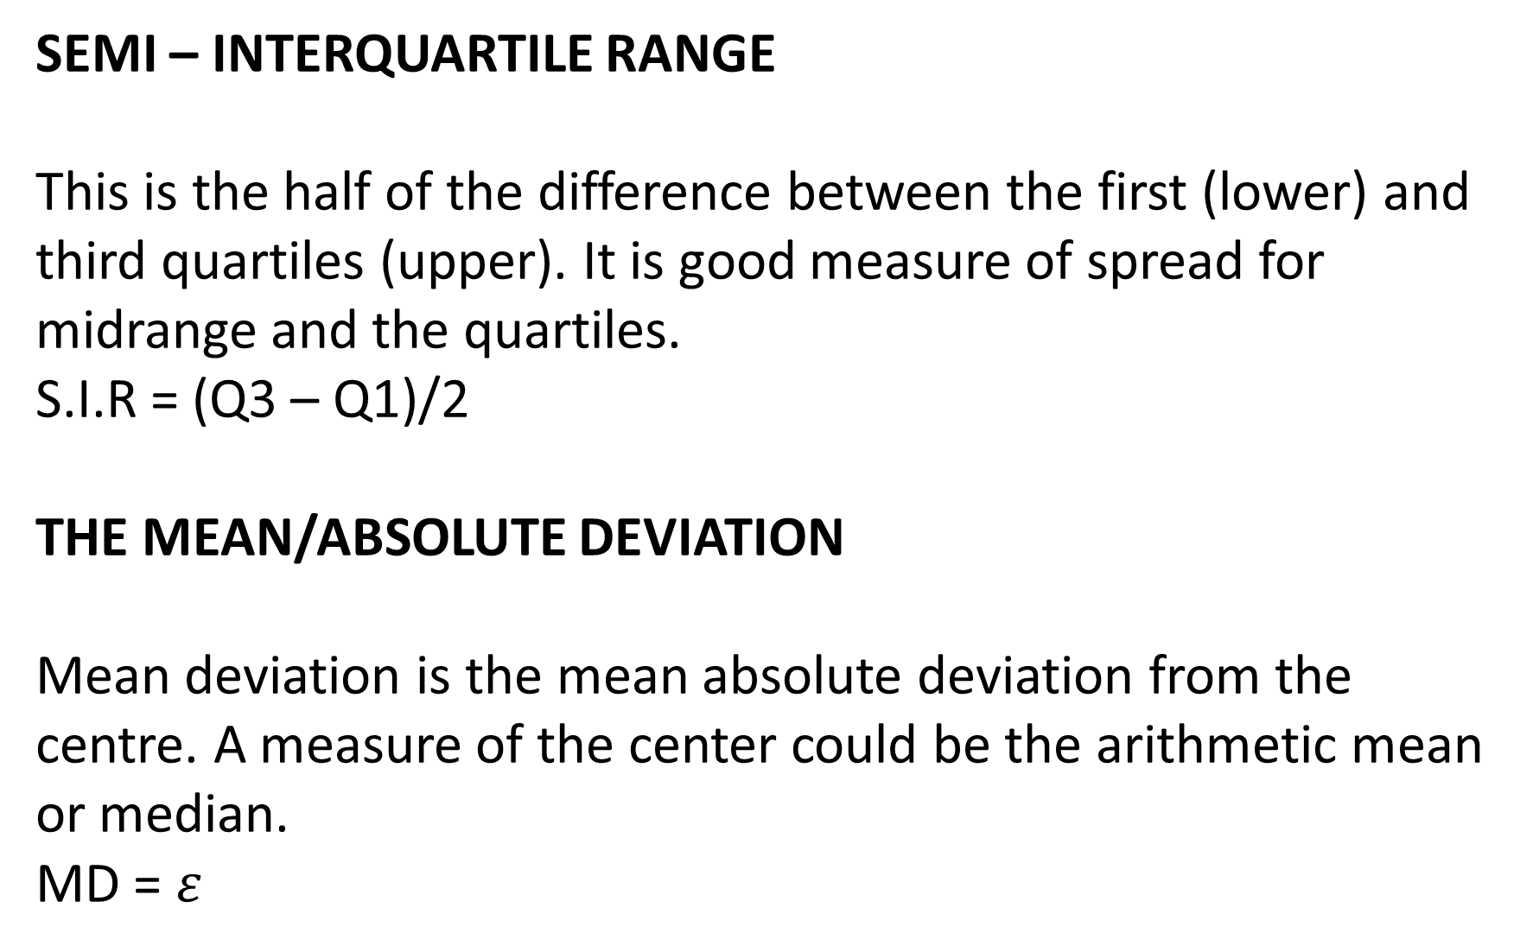
SEMI – INTERQUARTILE RANGE
This is the half of the difference between the first (lower) and third quartiles (upper). It is good measure of spread for midrange and the quartiles.
S.I.R = (Q3 – Q1)/2
THE MEAN/ABSOLUTE DEVIATION
Mean deviation is the mean absolute deviation from the centre. A measure of the center could be the arithmetic mean or median.
MD = $ε$

Slide 11
EXAMPLE
The table below shown the frequency distribution of the scores of 42 students in MTS 101
Scores 0 – 9 10 – 19 20 – 29 30 – 39 40 – 49 50 – 59 60 – 69
No of student 2 5 8 12 9 5 1
Find the mean deviation from the mean for the data.

